Slide 1
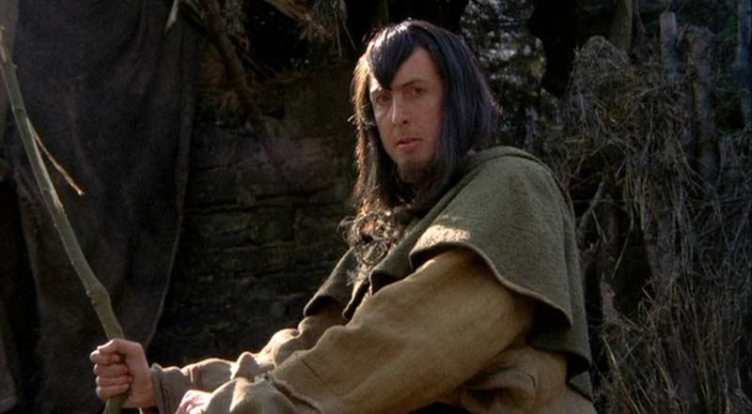
Binary Search Trees
"Yes. Shrubberies are my trade. I am a shrubber. My name is 'Roger the Shrubber'. I arrange, design, and sell shrubberies."
-Monty Python and The Holy Grail

Slide 2
The Problem with Linked Lists
Accessing a item from a linked list takes O(N) time for an arbitrary element
Binary trees can improve upon this and reduce access to O(log N) time for the average case
Expands on the binary search technique and allows insertions and deletions
Worst case degenerates to O(N) but this can be avoided by using balanced trees (AVL, Red-Black)
CS314
Binary Search Trees

Slide 3
Binary Search Trees
A binary search tree is a binary tree in which every node's left subtree holds values less than the node's value, and every right subtree holds values greater than the node's value.
A new node is added as a leaf.
root
parent
17
<
>
left child
11
19
right child
CS314
Binary Search Trees

Slide 4
BST Insertion
Add the following values one at a time to an initially empty binary search tree using the traditional, naïve algorithm:
90 20 9 98 10 28 -25
What is the resulting tree?
CS314
Binary Search Trees

Slide 5
Traversals
What is the result of an inorder traversal of the resulting tree?
How could a preorder traversal be useful?
CS314
Binary Search Trees

Slide 6
Quick Question 1
After adding N distinct elements in random order to a Binary Search Tree what is the expected height of the tree?
O(N^{1/2})
O(logN)
O(N)
O(NlogN)
O(N²)
CS314
Binary Search Trees

Slide 7
Quick Question 2
After adding N distinct elements in random order to a Binary Search Tree what is the worst case height of the tree?
O(N^{1/2})
O(logN)
O(N)
O(NlogN)
O(N²)
CS314
Binary Search Trees

Slide 8
Node for Binary Search Trees
public class BSTNode<E extends Comparable<E> {
private Comparable<E> myData;
private BSTNode<E> myLeft;
private BSTNode<E> myRightC;
public BinaryNode(E item)
{ myData = item; }
public E getValue()
{ return myData; }
public BinaryNode<E> getLeft()
{ return myLeft; }
public BinaryNode<E> getRight()
{ return myRight; }
public void setLeft(BSTNode<E> b)
{ myLeft = b; }
// setRight not shown
}
CS314
Binary Search Trees

Slide 9
Worst Case Performance
Insert the following values into an initially empty binary search tree using the traditional, naïve algorithm:
2 3 5 7 11 13 17
What is the height of the tree?
What is the worst case height of a BST?
CS314
Binary Search Trees

Slide 10
More on Implementation
Many ways to implement BSTs
Using nodes is just one and even then many options and choices
public class BinarySearchTree<E extends Comparable<E>> {
private BSTNode<E> root;
private int size;
CS314
Binary Search Trees

Slide 11
Quick Question 3
What are the best case and worst case order to add N distinct elements, one at a time, to an initially empty binary search tree?
Best Worst
O(N) O(N)
O(NlogN) O(NlogN)
O(N) O(NlogN)
O(NlogN) O(N²)
O(N²) O(N²)
// given int[] data
// no duplicates in
// data
BST<Integer> b =
new BST<Integer>();
for(int x : data)
b.add(x);
CS314
Binary Search Trees

Slide 12
Performance of Binary Trees
For the three core operations (add, access, remove) a binary search tree (BST) has an average case performance of O(log N)
Even when using the naïve insertion / removal algorithms
  no checks to maintain balance
  balance achieved based on the randomness of the data inserted
CS314
Binary Search Trees

Slide 13
Remove an Element
Three cases
  node is a leaf, 0 children (easy)
  node has 1 child (easy)
  node has 2 children (interesting)
CS314
Binary Search Trees

Slide 14
Properties of a BST
The minimum value is in the left most node
The maximum value is in the right most node
  useful when removing an element from the BST
CS314
Binary Search Trees

